Slide 1
CS4102 Algorithms Spring 2022
Can you fill a $8×8$ board with the corners missing using dominoes?
Can you tile this?
With these?

Slide 2
CS4102 Algorithms Spring 2022
Can you fill a $8×8$ board with the corners missing using dominoes?
Can you tile this?
With these?

Slide 3
Today’s Keywords
Dynamic Programming
Gerrymandering

Slide 4
Announcements
Unit B Adv and Programming due Friday 4/8
Unit C Adv and Programming coming soon

Slide 5
Dynamic Programming
Requires Optimal Substructure
Solution to larger problem contains the solutions to smaller ones
Idea:
Identify the recursive structure of the problem
What is the “last thing” done?
Save the solution to each subproblem in memory
Select a good order for solving subproblems
“Top Down”: Solve each recursively
“Bottom Up”: Iteratively solve smallest to largest

Slide 6
Generic Top-Down Dynamic Programming Soln
mem = {}
def myDPalgo(problem):
if mem[problem] not blank:
return mem[problem]
if baseCase(problem):
solution = solve(problem)
mem[problem] = solution
return solution
for subproblem of problem:
subsolutions.append(myDPalgo(subproblem))
solution = OptimalSubstructure(subsolutions)
mem[problem] = solution
return solution

Slide 7
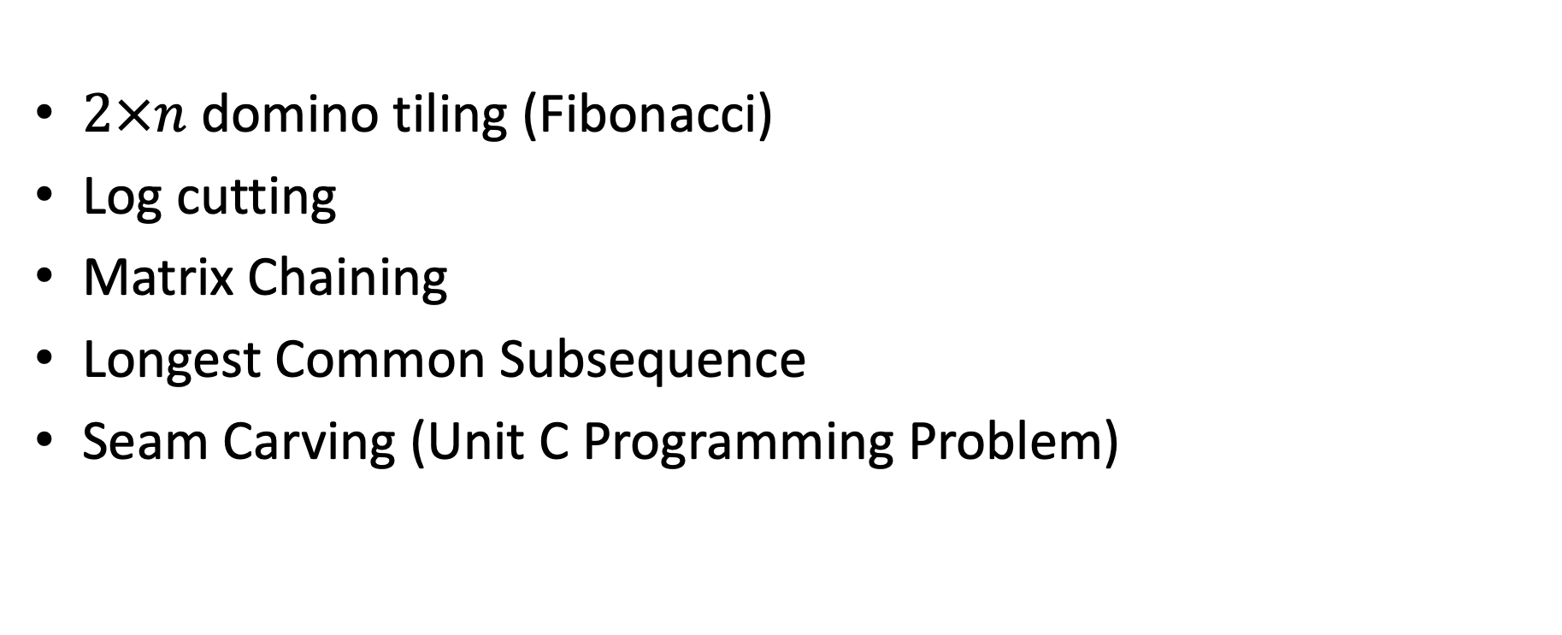
DP Algorithms so far
$2×n$ domino tiling (Fibonacci)
Log cutting
Matrix Chaining
Longest Common Subsequence
Seam Carving (Unit C Programming Problem)

Slide 8
Domino Tiling
Tile(n):
Initialize Memory M
M[0] = 0
M[1] = 0
for i = 0 to n:
M[i] = M[i-1] + M[i-2]
return M[n]
M
0
1
2
3
4
5
6

Slide 9
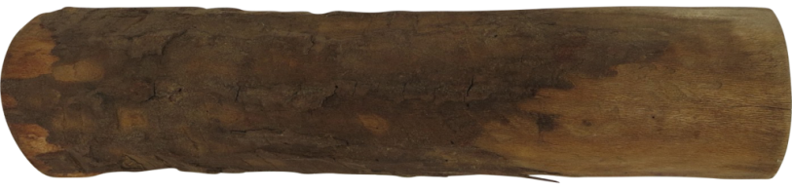

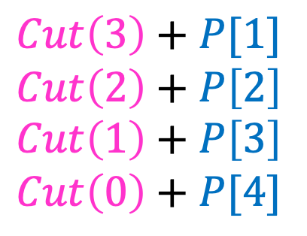

Log Cutting
Solve Smallest subproblem first
$Cut\left(3\right)+P[1]$
$Cut\left(2\right)+P\left[2\right]$
$Cut\left(1\right)+P\left[3\right]$
$Cut\left(0\right)+P[4]$
$Cut\left(4\right)=max⁡$
$Cut(i)$:
0
Length:
0
1
2
3
4
5
6
7
8
9
10
4

Slide 10
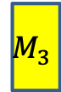
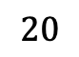

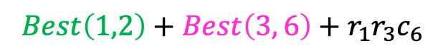
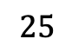

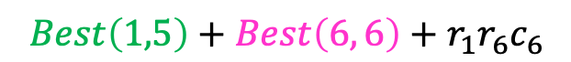
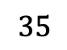
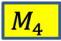

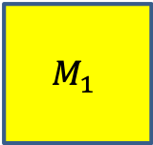
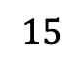
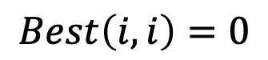

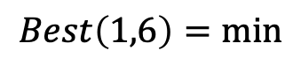
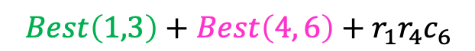


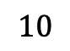
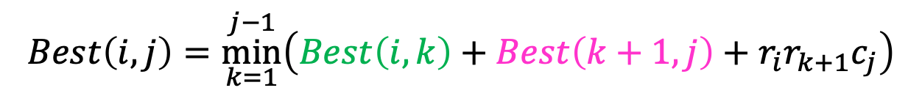


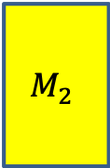
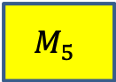

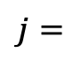
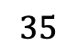


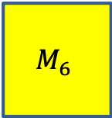
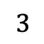


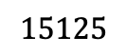
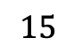
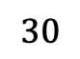

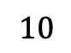

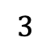
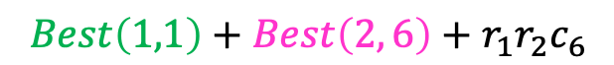
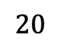
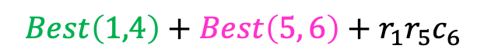
Matrix Chaining
$$35$$
$$15$$
$$5$$
$$10$$
$$20$$
$$25$$
$$M_{1}$$
$$M_{2}$$
$$M_{3}$$
$$M_{4}$$
$$M_{5}$$
$$M_{6}$$
$$30$$
$$×$$
$$35$$
$$×$$
$$15$$
$$×$$
$$5$$
$$×$$
$$10$$
$$×$$
$$20$$
$$Best\left(i,j\right)=\underset{k=1}{\overset{j−1}{min}}\left(Best\left(i,k\right)+Best\left(k+1, j\right)+r_{i}r_{k+1}c_{j}\right)$$
$$j=$$
$$1$$
$$2$$
$$3$$
$$4$$
$$5$$
$$6$$
$$=i$$
$$Best\left(i,i\right)=0$$
0
15750
7875
9375
11875
$$15125$$
$$1$$
0
2625
4375
7125
10500
$$2$$
0
750
2500
5375
$$3$$
$$Best\left(1,1\right)+Best\left(2, 6\right)+r_{1}r_{2}c_{6}$$
0
1000
3500
$$4$$
$$Best\left(1,2\right)+Best\left(3, 6\right)+r_{1}r_{3}c_{6}$$
$$Best\left(1,6\right)=min$$
$$Best\left(1,3\right)+Best\left(4, 6\right)+r_{1}r_{4}c_{6}$$
0
5000
$$5$$
$$Best\left(1,4\right)+Best\left(5, 6\right)+r_{1}r_{5}c_{6}$$
0
$$Best\left(1,5\right)+Best\left(6, 6\right)+r_{1}r_{6}c_{6}$$
$$6$$

Slide 11
Generic Top-Down Dynamic Programming Soln
mem = {}
def myDPalgo(problem):
if mem[problem] not blank:
return mem[problem]
if baseCase(problem):
solution = solve(problem)
mem[problem] = solution
return solution
for subproblem of problem:
subsolutions.append(myDPalgo(subproblem))
solution = OptimalSubstructure(subsolutions)
mem[problem] = solution
return solution

Slide 12
Generic Top-Down Dynamic Programming Soln
mem = [][]
Matrix = [] #1-D array of all 2-D matrices
def matrixChain(i,j):
if mem[i][j] not blank:
return mem[i][j]
if (j-i) == 0:
mem[i][j] = 0
return 0
if (j-i) == 1:
solution = size(Matrix[i]) * size(Matrix[j]) * size(Matrix[j][0]) #cost to multiply
mem[i][j] = solution
return solution
for k in i+1 .. j-1:
subsolutions.append(matrixChain(i,k) + matrixChain(k+1,j) + cost(i,k,j))
solution = min(subsolutions) # optimal substructure
mem[i][j] = solution
return solution

Slide 13
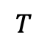

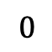
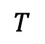
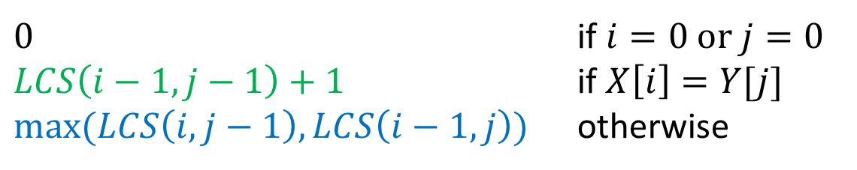
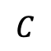



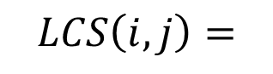

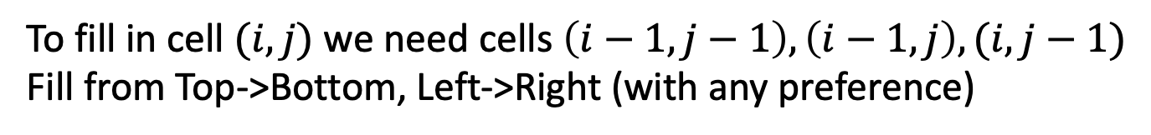
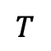

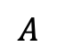


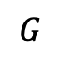
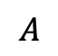

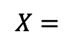
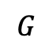


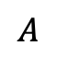
Longest Common Subsequence
$0$ if $i=0$ or $j=0$
$LCS\left(i−1,j−1\right)+1$ if $X\left[i\right]=Y[j]$
$\max{(LCS\left(i,j−1\right),LCS\left(i−1,j\right))}$ otherwise
$$LCS\left(i,j\right)=$$
$$X=$$
$$A$$
$$T$$
$$C$$
$$T$$
$$G$$
$$A$$
$$T$$
$$Y=$$
$$0$$
$$1$$
$$2$$
$$3$$
$$4$$
$$5$$
$$6$$
$$7$$
$$0$$
0 | 0 | 0 | 0 | 0 | 0 | 0 | 0
0 | 0 | 1 | 1 | 1 | 1 | 1 | 1
0 | 0 | 1 | 1 | 1 | 2 | 2 | 2
0 | 0 | 1 | 2 | 2 | 2 | 2 | 2
0 | 1 | 1 | 2 | 2 | 2 | 3 | 3
0 | 1 | 2 | 2 | 3 | 3 | 3 | 4
0 | 1 | 2 | 2 | 3 | 3 | 4 | 4
$$T$$
$$1$$
$$G$$
$$2$$
$$C$$
$$3$$
$$A$$
$$4$$
$$T$$
$$5$$
$$A$$
$$6$$
To fill in cell $(i,j)$ we need cells $\left(i−1,j−1\right),\left(i−1,j\right),(i,j−1)$
Fill from Top->Bottom, Left->Right (with any preference)

Slide 14
Seam Carving
Removes “least energy seam” of pixels
http://rsizr.com/, https://www.aryan.app/seam-carving/
Carved

Slide 15
Energy of a Seam
Sum of the energies of each pixel
$e\left(p\right)=$ energy of pixel $p$
Many choices
E.g.: change of gradient (how much the color of this pixel differs from its neighbors)
Particular choice doesn’t matter, we use it as a “black box”

Slide 16
Dynamic Programming
Requires Optimal Substructure
Solution to larger problem contains the solutions to smaller ones
Or: If S is an optimal solution to a problem, then the components of S are optimal solutions to sub-problems
Idea:
Identify the recursive structure of the problem
What is the “last thing” done?
Save the solution to each subproblem in memory
Select a good order for solving subproblems
“Top Down”: Solve each recursively
“Bottom Up”: Iteratively solve smallest to largest

Slide 17
Identify Recursive Structure
Let $S\left(i,j\right)=$least energy seam from the bottom of the image up to pixel $p_{i,j}$
$$p_{i,j}$$

Slide 18
Finding the Least Energy Seam
Want the least energy seam going from bottom to top, so delete:
$$\underset{k=1}{\overset{m}{min}}\left(S(n,k)\right)$$
$$p_{n,k}$$
$$n$$
$$m$$

Slide 19
Computing $S(n,k)$
Assume we know the least energy seams for all of row $n−1$
(i.e. we know $S(n−1,ℓ)$ for all $ℓ$)
$$p_{n,k}$$
Known through $n−1$
$$m$$

Slide 20
Computing $S(n,k)$
Assume we know the least energy seams for all of row $n−1$ (i.e. we know $S(n−1,ℓ)$ for all $ℓ$)
$$p_{n,k}$$
S(n,k)
S(n-1,k-1)
S(n-1,k)
S(n-1,k+1)

Slide 21
Computing $S(n,k)$
Assume we know the least energy seams for all of row $n−1$ (i.e. we know $S(n−1,ℓ)$ for all $ℓ$)
$$S\left(n−1,k−1\right)+e(p_{n,k})$$
$$S\left(n,k\right)=min$$
$$p_{n,k}$$
$$S\left(n−1,k\right)+e(p_{n,k})$$
S(n,k)
$$S\left(n−1,k+1\right)+e(p_{n,k})$$
S(n-1,k-1)
S(n-1,k)
S(n-1,k+1)

Slide 22
Seam Carving
Details left to you! Unit C Programming assignment
Note: Python or Java implementations only this time

Slide 23
Repeated Seam Removal
Only need to update pixels dependent on the removed seam
$2n$ pixels change
$Θ(2n)$ time to update pixels
$Θ(n+m)$ time to find min+backtrack
$$n$$
$$m$$

Slide 24
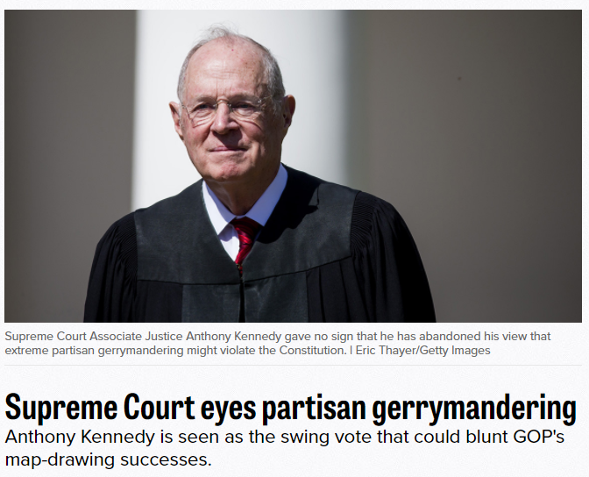

Slide 25
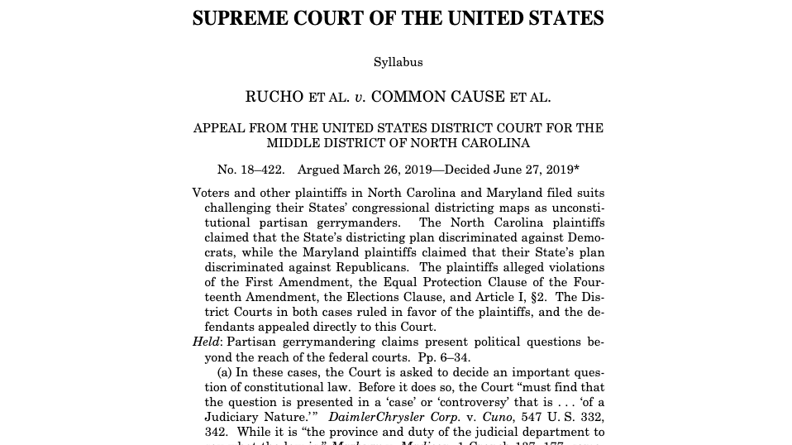
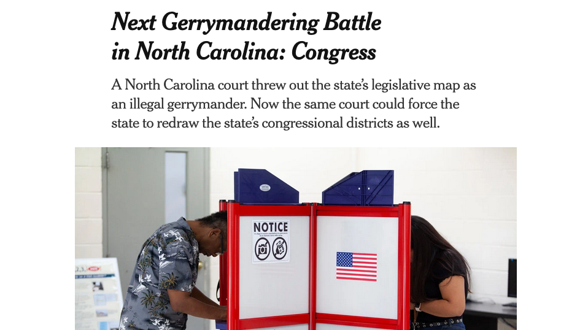
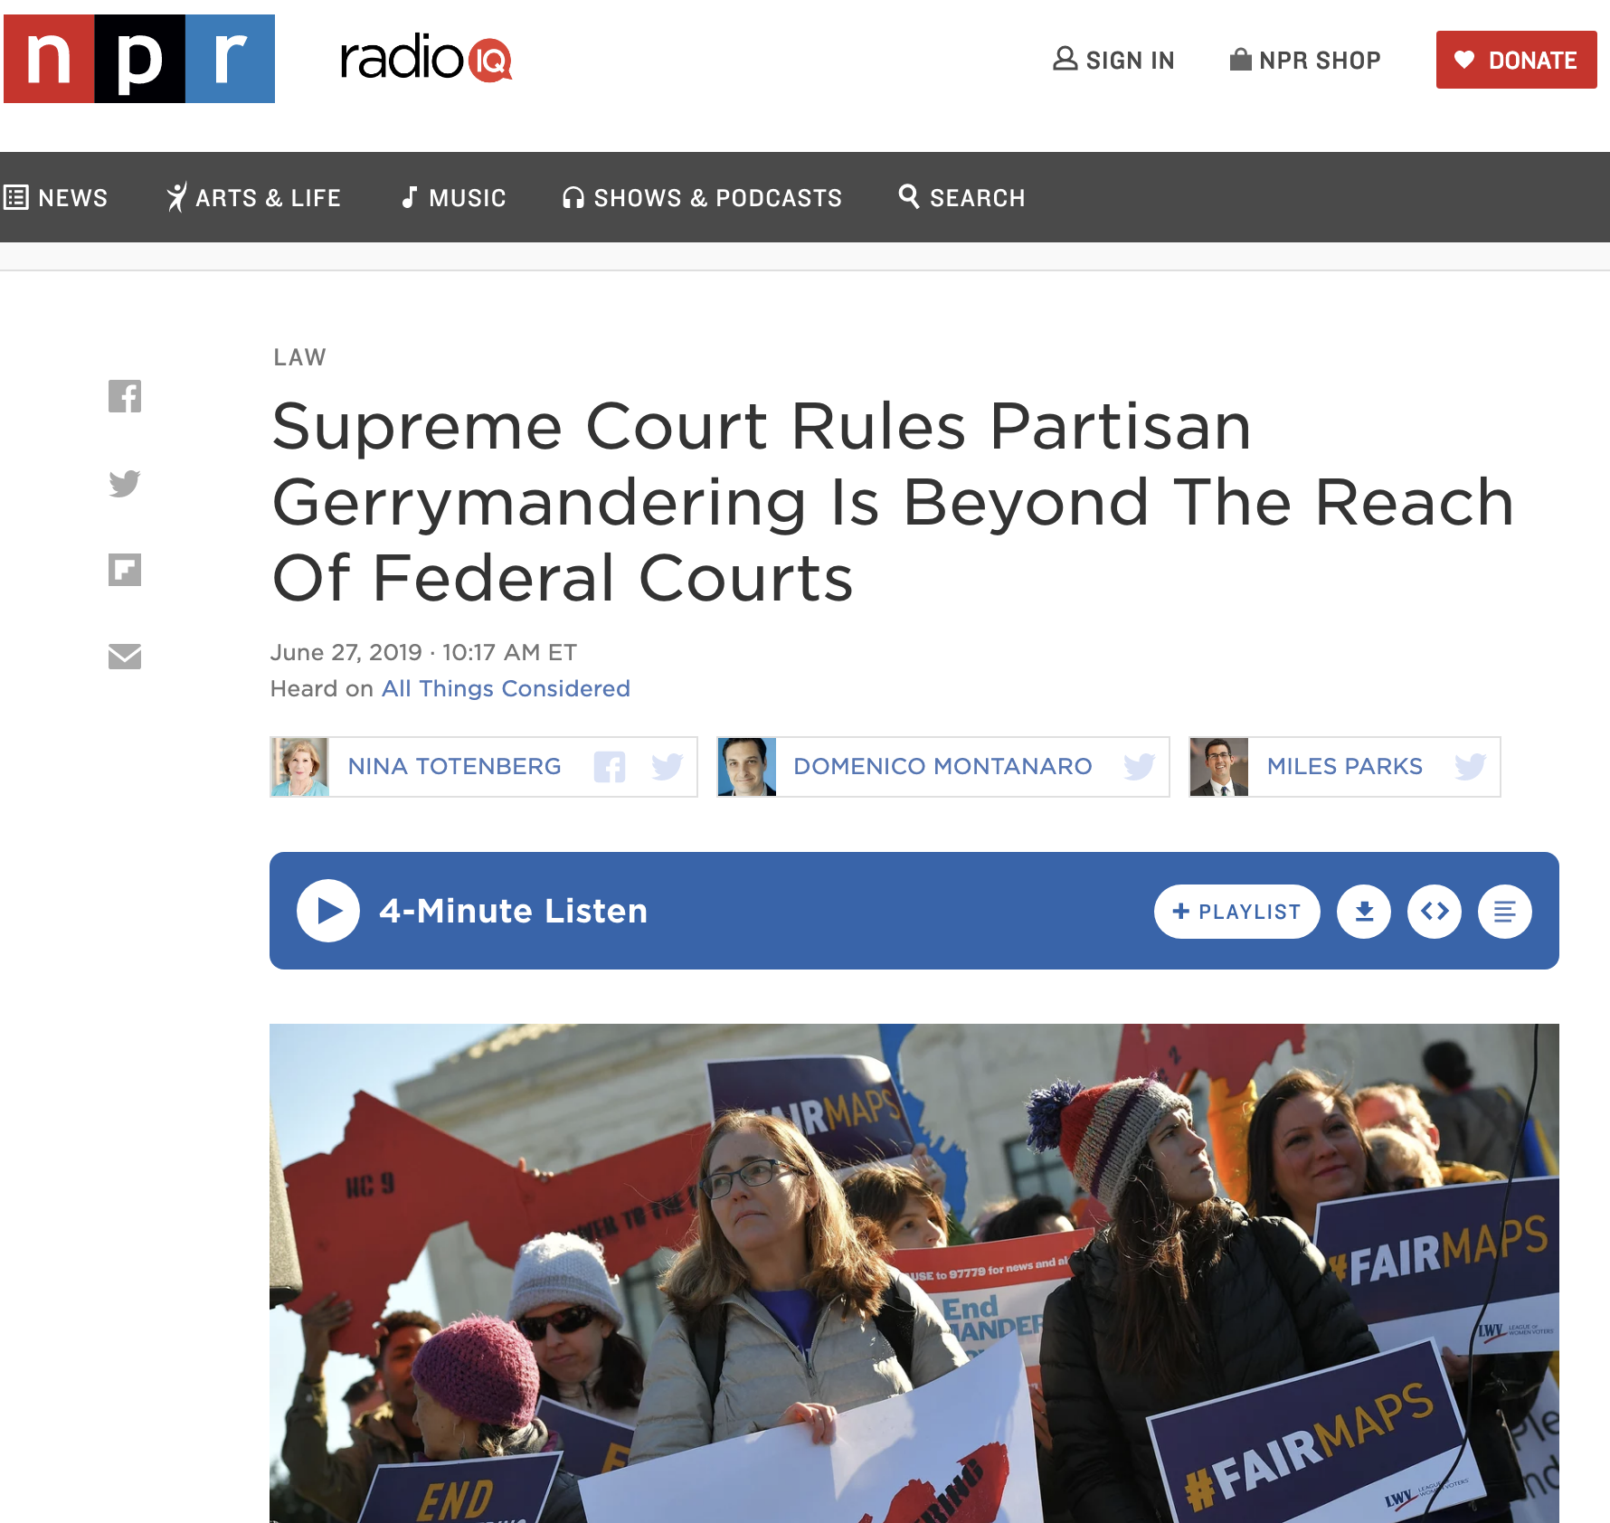

Slide 26
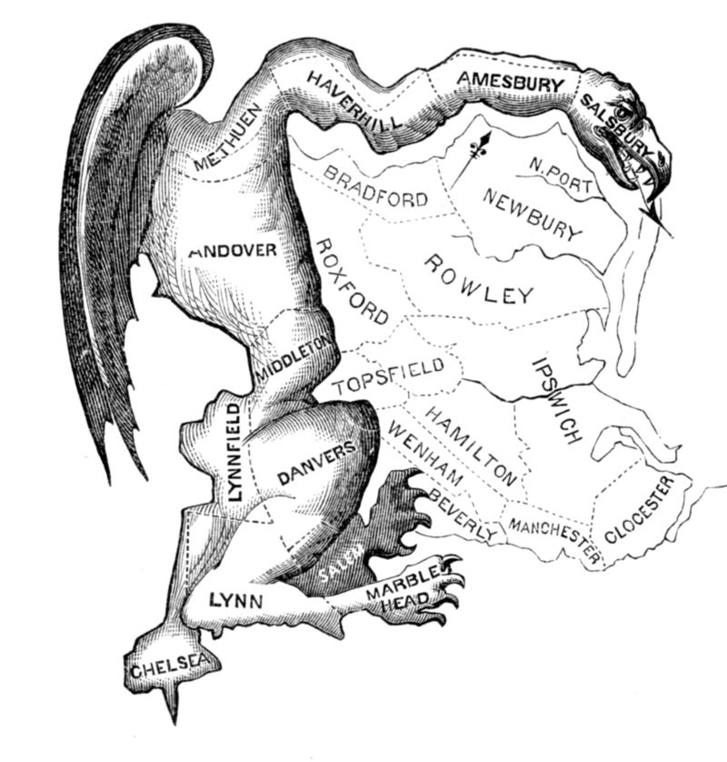
Gerrymandering
Manipulating electoral district boundaries to favor one political party over others
Coined in an 1812 Political cartoon
Governor Elbridge Gerry signed a bill that redistricted Massachusetts to benefit his Democratic-Republican Party
The Gerrymander

Slide 27
According to the Supreme Court
Gerrymandering cannot be used to:
Disadvantage racial/ethnic/religious groups
It can be used to:
Disadvantage political parties

Slide 28

VA 5th District

Slide 29


VA 5th District
2018 Election

Slide 30

5th District 2020 HR Results

Slide 31

Some Thinking Before 2012 VA Congressional Redistricting
From: “Incumbents, not voters, shaping Virginia’s congressional districts.” Washington Post, 2011

Slide 32

Political Reality and 2012 VA Congressional Redistricting

Slide 33
Gerrymandering Today
Computers make it really effective

Slide 34

Gerrymandering Today – Seriously?
Computers make it really effective
Close-up on part of 3rd District
This was 2013-2017; court ordered it changed
Virginia will do redistricting soon under a new system
Learn More about VA redistricting: https://www.vpap.org/redistricting/ https://redistricting.dls.virginia.gov/

Slide 35

VA State Senate District 25 (2020)
My house marked!

Slide 36

VA State Senate District 25 (2020)

Slide 37

VA State Senate District 25 (2020)
Learn More about VA redistricting: https://www.vpap.org/redistricting/ https://redistricting.dls.virginia.gov/

Slide 38

VA Redistricting – 2022-

Slide 39


Gerrymandering Today

Slide 40

An Algorithm to Gerrymander
It’s really a bit more complicated than this…
States are broken into precincts
All precincts have the same size
We know the votes for 2 parties in each precinct
Group precincts into districts to maximize the number of districts won by my party
The “Regular” Party
The “Diet” Party
Overall: R:217 D:183
Four precincts; 100 votes in each; Group into 2 districts
R:65
D:35
R:45
D:55
vs
R:60
D:40
R:47
D:53

Slide 41
How does it work?
States are broken into precincts
All precincts have the same size
We know the votes for 2 parties in each precinct
Group precincts into districts to maximize the number of districts won by my party
Overall: R:217 D:183
R:125 R:92
R:112 R:105
R:65
D:35
R:45
D:55
R:65
D:35
R:45
D:55
R:65
D:35
R:45
D:55
R:60
D:40
R:47
D:53
R:60
D:40
R:47
D:53
R:60
D:40
R:47
D:53

Slide 42


Gerrymandering Problem Statement
Given:
A list of precincts $p_{1},p_{2},…,p_{n}$ and $R\left(p_{i}\right)$, number of votes for “Regular Party”
Each precinct has exactly $m$ voters (So $mn$ total voters)
Output:
Two districts $D_{1},D_{2}⊂\{p_{1},p_{2},…,p_{n}\}$
Where $\left|D_{1}\right|=|D_{2}|$
So exactly $\frac{mn}{2}$ votes per district
$R\left(D_{1}\right)>\frac{mn}{4} and R\left(D_{2}\right)>\frac{mn}{4}$
$R(D_{i})$ gives number of “Regular Party” voters in $D_{i}$
$R\left(D_{i}\right)>\frac{mn}{4}$ means $D_{i}$ is majority “Regular Party”
“failure” if no such solution is possible
Valid Gerrymandering: Both districts go to Regular Party!
More than 50% of the $\frac{mn}{2}$ votes

Slide 43
Dynamic Programming
Requires Optimal Substructure
Solution to larger problem contains the solutions to smaller ones
Idea:
Identify the recursive structure of the problem
What is the “last thing” done?
Save the solution to each subproblem in memory
Select a good order for solving subproblems
“Top Down”: Solve each recursively
“Bottom Up”: Iteratively solve smallest to largest

Slide 44
Dynamic Programming
Requires Optimal Substructure
Solution to larger problem contains the solutions to smaller ones
Idea:
Identify the recursive structure of the problem
What is the “last thing” done?
Save the solution to each subproblem in memory
Select a good order for solving subproblems
“Top Down”: Solve each recursively
“Bottom Up”: Iteratively solve smallest to largest

Slide 45

















Consider the last precinct
World One
After assigning the first $n−1$ precincts $$p_{1},p_{2},…,p_{n−1}$$
$$D_{1} \\ k+1 \text{precincts}$$
$$x+R(p_{n}) \text{voters} \text{for} \text{R}$$
$$D_{1}$$
$k+1$ precincts
$x+R(p_{n})$ voters for R
If we assign $p_{n}$to $D_{1}$
$$D_{1}$$
$$D_{2} \\ n−k−1 \text{precincts}$$
$$y \text{voters} \text{for} \text{R}$$
$k$ precincts
$x$ voters for R
Valid gerrymandering if:
$k+1=\frac{n}{2}$,
$x+R\left(p_{n}\right),y>\frac{mn}{4}$
$$p_{n}$$
$$D_{2}$$
$n−k−1$ precincts
$y$ voters for R
World Two
$$D_{2}$$
$$D_{1} \\ k \text{precincts}$$
$$x \text{voters} \text{for} \text{R}$$
If we assign $p_{n}$to $D_{2}$
$n−k$ precincts
$y+R(p_{n})$ voters for R
$$D_{2} \\ n−k \text{precincts}$$
$$y+R(p_{n}) \text{voters} \text{for} \text{R}$$
Valid gerrymandering if:
$n−k=\frac{n}{2}$,
$x,y+R\left(p_{n}\right)>\frac{mn}{4}$

Slide 46



Define Recursive Structure
$$S\left(j,k,x,y\right)=$$
True if from among the first $j$ precincts:
$k$ are assigned to $D_{1}$
exactly $x$ vote for R in $D_{1}$
exactly $y$ vote for R in $D_{2}$
$$n × n × mn × mn$$
4D Dynamic Programming!!!

Slide 47


















Two ways to satisfy $S\left(j,k,x,y\right)$:
$$D_{1}$$
$S\left(j,k,x,y\right)=$ True if:
from among the first $j$ precincts
$k$ are assigned to $D_{1}$
exactly $x$ vote for R in $D_{1}$
exactly $y$ vote for R in $D_{2}$
$k−1$ precincts
$x−R(p_{j})$ voters for R
$$p_{j}$$
$$D_{2}$$
Then assign $p_{j}$to $D_{1}$
$j−k$ precincts
$y$ voters for R
$$D_{1}$$
OR
$k$ precincts
$x$ voters for R
$$D_{1}$$
$k$ precincts
$x$ voters for R
$$D_{2}$$
$j−k$ precincts
$y$ voters for R
$$p_{j}$$
$$D_{2}$$
$j−1−k$ precincts
$y−R(p_{j})$ voters for R
Then assign $p_{j}$to $D_{2}$
$$S\left(j,k,x,y\right)=S\left(j−1,k−1,x−R\left(p_{j}\right), y\right)∨S\left(j−1,k,x,y−R\left(p_{j}\right)\right)$$

Slide 48



Final Algorithm
$$S\left(j,k,x,y\right)=S\left(j−1,k−1,x−R\left(p_{j}\right), y\right)∨S\left(j−1,k,x,y−R\left(p_{j}\right)\right)$$
Initialize $S(0,0,0,0)=$ True
for $j=1,…,n$:
for $k=1,…,min⁡(j,\frac{n}{2})$:
for $x=0,…,jm$:
for $y=0,…,jm$:
$S\left(j,k,x,y\right)=$
$$S\left(j−1,k−1,x−R\left(p_{j}\right), y\right)∨S\left(j−1,k,x,y−R\left(p_{j}\right)\right)$$
Search for True entry at $S(n,\frac{n}{2},>\frac{mn}{4},>\frac{mn}{4})$
$S\left(j,k,x,y\right)=$ True if:
from among the first $j$ precincts
$k$ are assigned to $D_{1}$
exactly $x$ vote for R in $D_{1}$
exactly $y$ vote for R in $D_{2}$

Slide 49





Run Time
$$S\left(j,k,x,y\right)=S\left(j−1,k−1,x−R\left(p_{j}\right), y\right)∨S\left(j−1,k,x,y−R\left(p_{j}\right)\right)$$
Initialize $S(0,0,0,0)=$ True
for $j=1,…,n$:
for $k=1,…,min⁡(j,\frac{n}{2})$:
for $x=0,…,jm$:
for $y=0,…,jm$:
$S\left(j,k,x,y\right)=$
$$S\left(j−1,k−1,x−R\left(p_{j}\right), y\right)∨S\left(j−1,k,x,y−R\left(p_{j}\right)\right)$$
Search for True entry at $S(n,\frac{n}{2},>\frac{mn}{4},>\frac{mn}{4})$
$$n$$
$$\frac{n}{2}$$
$$Θ(n^{4}m^{2})$$
$$nm$$
$$nm$$

Slide 50





Can We Visualize this 4D “Table”?
$S\left(j,k,x,y\right)=$ True if:
from among the first $j$ precincts
$k$ are assigned to $D_{1}$
exactly $x$ vote for R in $D_{1}$
exactly $y$ vote for R in $D_{2}$
$$n$$
$$n/2$$
$$nm$$
$$nm$$
To get a solution: search for True entry at $S(n,\frac{n}{2},>\frac{mn}{4},>\frac{mn}{4})$

Slide 51

$$Θ(n^{4}m^{2})$$
This looks big! Yes, and it’s interesting too! ☺
Inputs:
List (size $n$) of precincts and counts of voters for Regular Party, $R\left(p_{i}\right)$
Number of voters (integer $m$)
$n$ is a size of one of the inputs
If $n$ doubles, twice as many items in the list that’s our input
But $m$is an input value (not a size)
If $m$ doubles, it’s still one integer, one input item
But the amount of work grows
The complexity depends on the size of this single integer

Slide 52

Size of a Numeric Input-Value
Question: How do we measure the size of an integer?
Answer: the number of bits to represent it.
Example: The value 4 (decimal) in binary is 100, so the size of “value 4” is 3.
If the size grows by 1, that’s 4 bits. With 4 bits, the value could be 1000 or 8 decimal.
Wait, what? Size of input grows by 1, and the value doubles (4 to 8). That sounds like exponential! $2^{n}$vs. $2^{n+1}$

Slide 53

Pseudo-Polynomial Time
Yes, the inputSize (in bits) of value $m$ is $\log_{2}{m}$ $inputSize{=log}_{2}{m}$
$m=2^{inputSize}$
So $m^{2}={{(2}^{inputSize})}^{2}$= $2^{2∙inputSize}$
Gerrymandering’s run-time is exponential because of size of input $m$
Because run-time $Θ\left(n^{4}m^{2}\right)$ written in terms of the value of $m$, not the size of $m$
Input size is really $n+\left|m\right|=n+\log{m}$
This is called pseudo-polynomial time (https://en.wikipedia.org/wiki/Pseudo-polynomial_time)
We’ve seen others like this! Knapsack DP $Θ(n∙C)$ and Coin-changing DP $Θ(n∙A)$

